Slide 2

Automation using Protractor – Session 3
- Abhay Singh - Reetika Nigam

Slide 3
Brief Outline
What is BDD
When to use BDD
Cucumber
Gherkin Language
Cucumber – Feature File
Cucumber – Step Definition File
Different components of cucumber
Cucumber BDD
Feature file | Keywords
Protractor with cucumber
Assertions: Chai and Chai-As-Promised
Protractor HTML Report

Slide 4
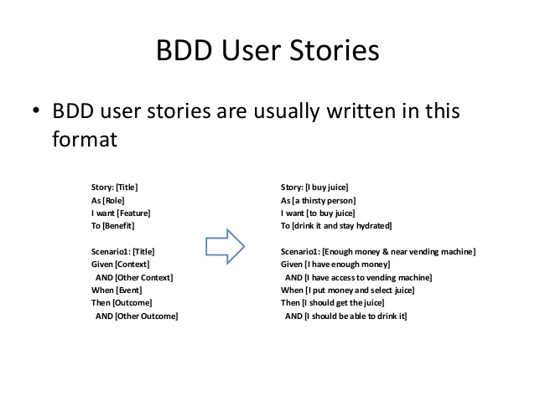
What is BDD
BDD is Behaviour Driven Development
Tests are written in a non-technical language that everyone can understand. It forms an approach for building a shared understanding on what kind of software to build by discussing examples. We create executable specifications

Slide 5
When to use BDD
Your cucumber features should drive your implementation, not reflect it.
The client is Agile friendly
Cucumber is a collaboration tool. BDD can only be implemented when the processes are set where the people in charge for defining the requirements sit down with programmers and testers and discuss a feature to be implemented.
If you don’t have non-technical folk collaborating with you on your specifications, try writing plain automated tests instead.

Slide 6
Cucumber
Cucumber is a testing tool that supports Behavior Driven Development (BDD) framework
It defines application behavior using simple English text, defined by a language called Gherkin.
Cucumber can be used to automate tests which are easily read and understood
It acts as a bridge between the business and technical language. We can accomplish this by creating a test case in plain English text.
These test cases/test scripts are defined in feature files. These features files act as executable specifications

Slide 7
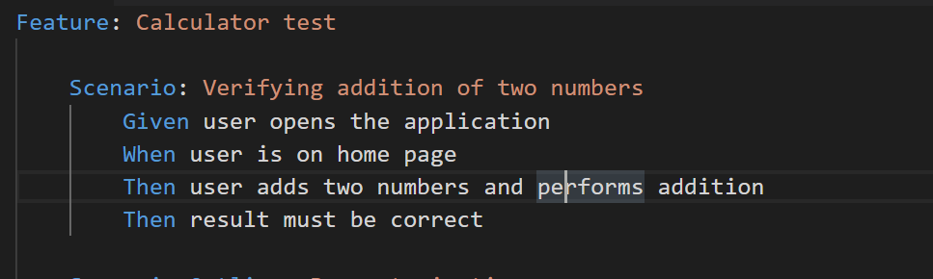
Gherkin Language
It is a common language between Clients, Developers, Testers, Business analysts and the Managers to illustrate business requirements
The language, in which this executable feature files is written, is known as Gherkin
Gherkin uses a set of special keywords to give structure and meaning to executable specifications
It is a plain English text language, which helps the tool - Cucumber to interpret and execute the test scripts.
For each statement written in feature file an executable step should be declared in the step definition file

Slide 8
Cucumber – Feature File
A Feature File is an entry point to the Cucumber tests.
This is a file where you will describe your tests in Descriptive language (Like English)
It is an essential part of Cucumber, as it serves as an automation test script as well as live documents
A feature file can contain a scenario or can contain many scenarios in a single feature file
In order for Cucumber to automatically detect the features, you need to make sure that they carry the ‘.feature‘ file extension. For example ‘Login.feature‘.
A Feature can be defined as a standalone unit or functionality of a project. For e.g. Login, Browse items, Cart

Slide 9
Cucumber – Step Definition File
Step Definitions is where the automation code is written.
The steps in the gherkin file directly map to the step definitions. Each step in the gherkin maps to a step definition that in turn contains a block of code that gets executed when the scenario is run
If any line of code inside the step definition returns an error or exception to the Cucumber Runner, then that step is marked as failed, otherwise pass.
Automation code can further refer to the support system for including modules, classes, libraries etc [For example it can include selenium library to handle browser UI automation]
The support system in turn depends on the packages/libraries provided by the programming language stack that is used. In Ruby, it is called gems and in Java it is called jars.

Slide 10
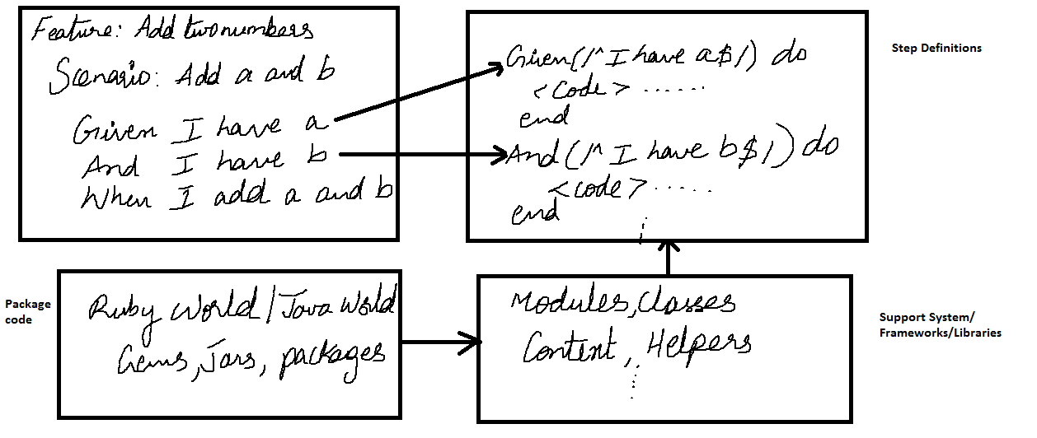
Cucumber – Step Definition File

Slide 11
Different components of Cucumber
Feature File
Scenarios
Scenario outline
Tags
Runner- Config.js

Slide 12
Cucumber - BDD
Steps to follow to implement BDD
Identify business features.
Identify scenarios under the selected feature.
Define steps for each scenario.
Dev team does the development keeping in mind the scenarios.
QA team automates the scenarios using progressive automation
The Dev team should write unit test cases and test team should write low level functional test cases
Unit test cases should be run on the developed code
Once the feature is developed run the automated acceptance test cases.
For intermediate deliveries run the low - level functional test cases.
All the test cases should pass on the final build

Slide 13
Feature File | Keywords
Feature
Defines what feature you will be testing in the tests. The purpose of the Feature keyword is to provide a high-level description of a software feature, and to group related scenarios. The first primary keyword in a Gherkin document must always be Feature, followed by a : and a short text that describes the feature. These description lines are ignored by Cucumber at runtime, but are available for reporting (They are included by default in html reports). The free format description for Feature ends when you start a line with the keyword Scenario or Scenario Outline
Scenario
A scenario is a test. Scenario consist of a list of steps. Each step consists of Given, When, Then, And, or But. Cucumber executes each step in a scenario one at a time, in the sequence you’ve written them in. When Cucumber tries to execute a step, it looks for a matching step definition to execute. Keywords are not taken into account when looking for a step definition. This means you cannot have a Given, When, Then, And or But step with the same text as another step.

Slide 14
Feature File | Keywords
Given
Tells the pre-condition of the test. Generally in this section we create pre conditions like opening a browser, navigating to application home page. You can have multiple Given steps
When
When steps are used to describe an event, or an action.
Then
Then steps are used to describe an expected outcome, or result. It is generally the expected result of the test. Then step should use an assertion to compare the actual outcome (what the system actually does) to the expected outcome (what the step says the system is supposed to do).

Slide 15
Steps
1. Creating a new project: ‘npm’ init from new directory
Installations:
a) npm install --save-dev cucumber
b) npm install --save-dev protractor-cucumber-framework
c) npm install --save-dev chai
Check package.json for dependencies
Create config.js file for cucumber
Install cucumber(Gherkin) Full Support plugin of Visual Studio Code from market place
Restart VSC to apply changes
Create a feature file
Generate glue code by running protractor config.js
Create step definition file and paste glue code in it
Use chai for assertion library
Write code for Given, When, Then in spec.js file
Apply tags in feature file

Slide 16
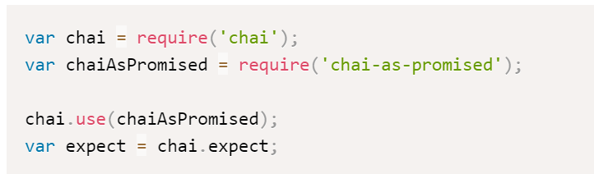
Chai Assertions
Since we are using the custom framework option with Protractor we need to add an assertion library like Chai — a popular choice. Chai allows us to write assertions in a simple, readable style — such as the familiar expect syntax :
expect(element.getText()).to.eventually.equal('Name’);.
To install, you should run npm install chai chai-as-promised. Within the step definition file or config file, add the following lines to the top of the file:

Slide 17
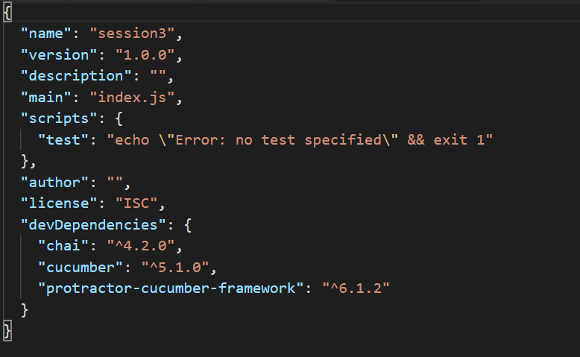
Package.json

Slide 18
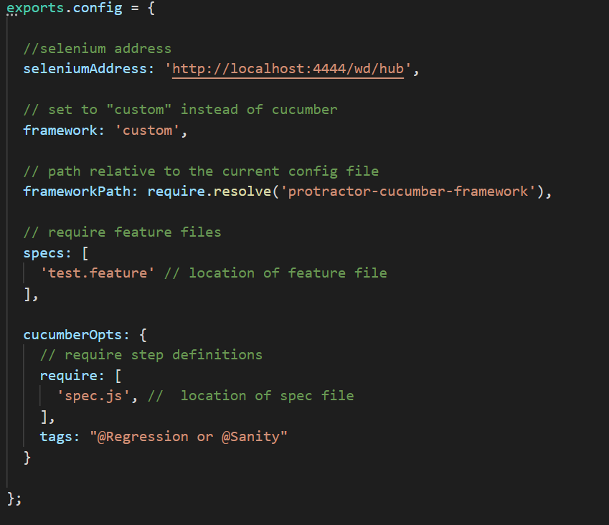
Config File

Slide 19
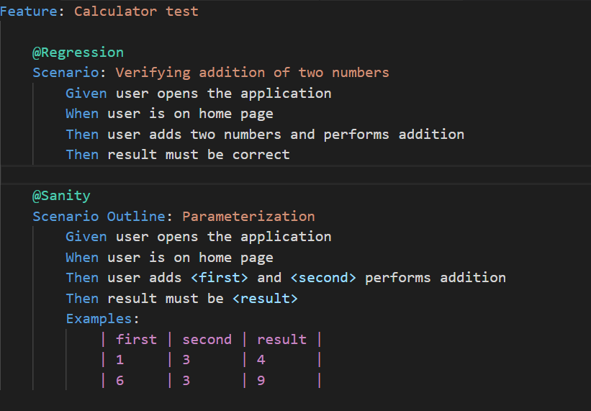
Feature File Example

Slide 20
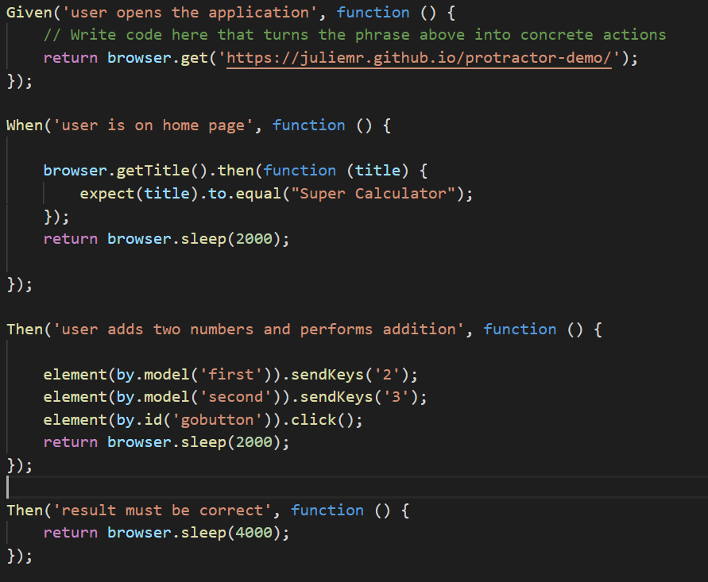
Step Definition File Example : spec file

Slide 21
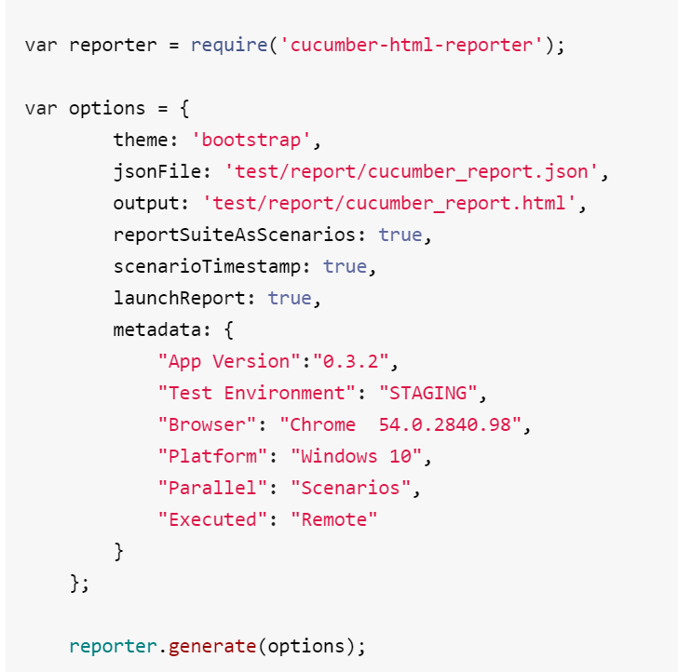
Cucumber HTML Report
Provide Cucumber JSON report file created from your framework and this module will create pretty HTML reports. Install :
npm install cucumber-html-reporter --save-dev Create a conf.js file and specify the options.

Slide 22
References
https://blog.imaginea.com/e2e-why-to-use-protractor-over-selenium-for-angular-apps/
https://semaphoreci.com/community/tutorials/getting-started-with-protractor-and-cucumber
https://medium.com/@tuliobluz/automa%C3%A7%C3%A3o-com-protractor-pageobject-e-cucumber-122537179ab7
https://medium.com/@praveendavidmathew/creating-html-reports-for-protractor-7d9830ebf428
https://www.npmjs.com/package/cucumber-html-reporter

Slide 23


Slide 24
Quality at the speed of digital Thank YOU

